Slide 1
Database Design
Presented to : Dr. Charbel Obeid
Student : Youssef Eid & Hassan Khadra
Project : Group 14

Slide 2
Group 14
A company has one or more locations referred to as "Plant" (Plant-ID). Several plants are uniquely assigned to the same company code (CC-ID) .
We created 2 entities: “Plant” and “Company Code”.
“Plant” has the primary key [Plant-ID] and “Company Code” has the primary key [CC-ID]. The relation name between them is AssignedTo and it’s a 1:N relation.
Plants can have several storage locations (S-loc-#) in which the manufactured and purchased items are stocked, a storage location, however, can only be assigned to one plant.
We created a new entity: “Storage Location”.
“Storage Location” has the primary key [S-loc-#] and an attribute “Item”
The relation name between “Storage Location” and “Plant” is AllocatedTo and it’s a 1:N relation.

Slide 3
Group 14
A purchase organization (PO-ID) can be assigned to several plants and a plant to several purchase organizations. A company code is related to one or more purchase organizations, the latter is uniquely related to a company code.
We created a new entity: “Purchase Organization”.
“Purchase Organization” has the primary key [PO-ID].
The relation name between “Purchase Organization” and “Plant” is DeterminedTo and it’s a N:M relation.
The relation name between “Purchase Organization” and “Company Code” is RelatedTo and it’s a 1:N relation.
A distribution channel (DC-#) can be assigned to several divisions (Div-ID), whereas a division is uniquely assigned to a distribution channel.
We created 2 entities: “Distribution Channel” and “Division”.
“Distribution Channel” has the primary key [DC-#] and “Division” has the primary key [Div-ID].
The relation name between them is DesignatedTo and it’s a 1:N relation.

Slide 4
Group 14
A sales organization (Sales-Org-ID) can have several distribution channels, whereas a distribution channel is uniquely assigned to a sales organization.
We created a new entity: “Sales Organization”.
“Sales Organization” has the primary key [Sales-Org-ID].
The relation name between “Sales Organization” and “Distribution Channel” is have and it’s a 1:N relation.
A company code can have several sales organizations. Sales organizations are assigned to one company code only and several plants. Plants can also be assigned to several sales organizations.
The relation name between “Sales Organization” and “Company Code” is AttachedTo and it’s a 1:N relation.
The relation name between “Sales Organization” and “Plant” is AppointedTo and it’s a N:M relation.

Slide 5
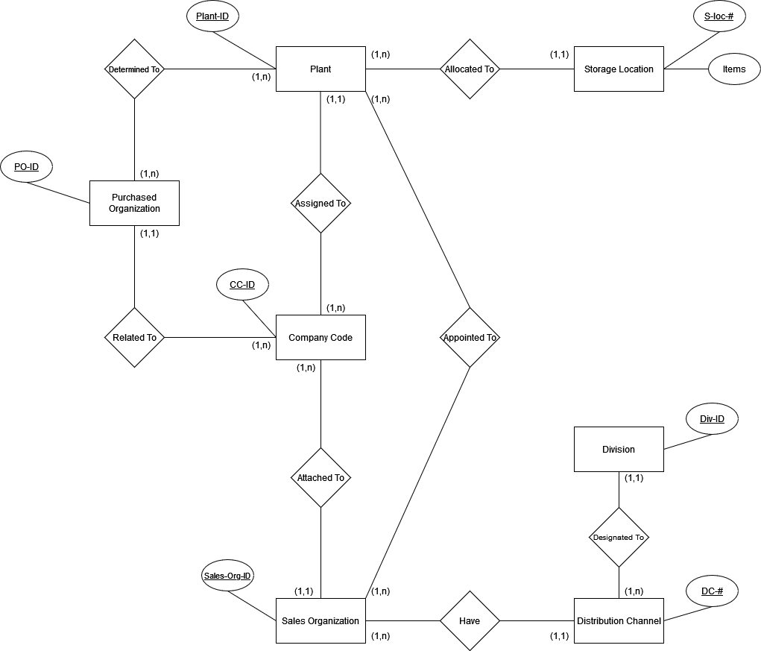
Conceptual Model

Slide 6

Relational Model

Slide 7
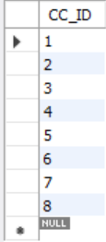
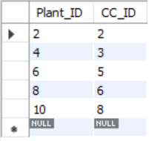
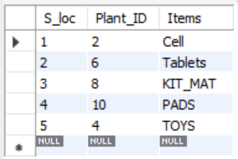
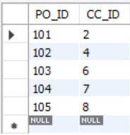
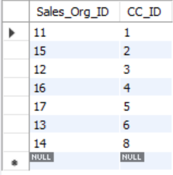
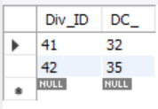
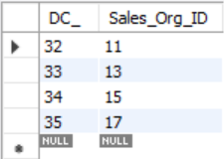
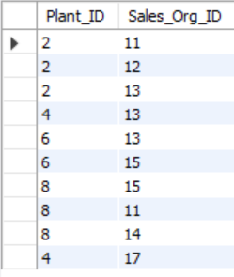
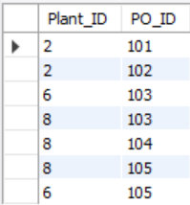
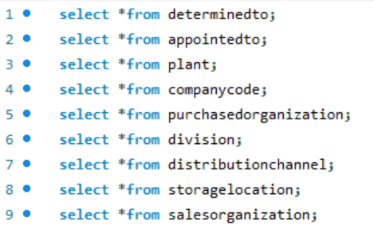
Physical Model
Company Code
Plant
Storage Location
Purchased Organization
Sales Organization
Division
Distribution Channel
Appointed To
Determined To
MySql Display

Slide 8
Physical Model – MySql
Creating the tables:
Create table CompanyCode(CC_ID int not null, primary key(CC_ID));
create table Plant(Plant_ID int not null, CC_ID int not null, primary key(Plant_ID), foreign key (CC_ID) references CompanyCode(CC_ID));
create table StorageLocation(S_loc int not null, Plant_ID int not null, Items varchar(50) null, primary key(S_loc), foreign key (Plant_ID) references Plant(Plant_ID));
create table PurchasedOrganization(PO_ID int not null, CC_ID int not null, primary key(PO_ID), foreign key (CC_ID) references CompanyCode(CC_ID));
create table SalesOrganization(Sales_Org_ID int not null, CC_ID int not null, primary key(Sales_Org_ID), foreign key (CC_ID) references CompanyCode(CC_ID));
create table DistributionChannel(DC_ int not null, Sales_Org_ID int not null, primary key(DC_), foreign key (Sales_Org_ID) references salesorganization(Sales_Org_ID));
create table Division(Div_ID int not null, DC_ int not null, primary key(Div_ID), foreign key (DC_) references distributionchannel(DC_));
create table AppointedTo(Plant_ID int not null, Sales_Org_ID int not null, foreign key(Plant_ID) references plant(Plant_ID), foreign key (Sales_Org_ID) references salesorganization(Sales_Org_ID));
create table DeterminedTo(Plant_ID int not null, PO_ID int not null, foreign key(Plant_ID) references plant(Plant_ID), foreign key (PO_ID) references purchasedorganization(PO_ID));

Slide 9
Physical Model – MySql
Inserting into the tables (only showing 1 example for each table) :
insert into companycode(CC_ID)values(1);
insert into plant(Plant_ID, CC_ID)values(2, 2);
insert into storagelocation(S_loc, Plant_ID, Items)values(1, 2,'Cell');
insert into salesorganization(Sales_Org_ID, CC_ID)values(11, 1);
insert into distributionchannel(DC_, Sales_Org_ID)values(32, 11);
insert into division(Div_ID, DC_)values(41, 32);
insert into appointedto(Plant_ID,Sales_Org_ID)values(2, 11);
insert into purchasedorganization(PO_ID,CC_ID)values(101,2);
insert into determinedto(Plant_ID, PO_ID)values(2,101);

Slide 10

Physical Model – MySql
Few MySql exercises:
1-a. Give the number of data in table Company Code having more than 3 records in table Sales Organization:
select count(*) as Counter from companycode where (select salesorganization.CC_ID from salesorganization where companycode.CC_ID = salesorganization.CC_ID group by salesorganization.CC_ID having count(salesorganization.CC_ID) >3);
Company Code
Sales Organization
Results ➔

Slide 11

Physical Model – MySql
Few MySql exercises:
1-b. Give the number of data in table Company Code having more than or equal to 1 record in table Sales Organization:
select count(*) as Counter from companycode where (select salesorganization.CC_ID from salesorganization where companycode.CC_ID = salesorganization.CC_ID group by salesorganization.CC_ID having count(salesorganization.CC_ID) >= 1);
Company Code
Sales Organization
Results ➔

Slide 12
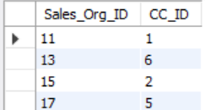
Physical Model – MySql
Few MySql exercises:
2-a. Show the data that occure in table Sales Organization having the maximum number of data in table Distribution Channel and order them by their count.
select salesorganization.Sales_Org_ID, salesorganization.CC_ID from salesorganization, distributionchannel where distributionchannel.Sales_Org_ID = salesorganization.Sales_Org_ID group by salesorganization.Sales_Org_ID, salesorganization.CC_ID order by count(*);
The method we did is by selecting all data in table Sales Organization and order them by the number of times each data figured in table Distribution Channel.
Sales Organization
Distribution Channel
Results ➔

Slide 13
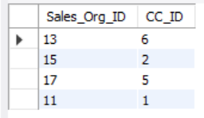
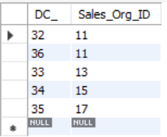
Physical Model – MySql
Few MySql exercises:
2-b. Repeat the same after inserting more data to show different results.
insert into distributionchannel(DC_, Sales_Org_ID)values(36, 11);
select salesorganization.Sales_Org_ID, salesorganization.CC_ID from salesorganization, distributionchannel where distributionchannel.Sales_Org_ID = salesorganization.Sales_Org_ID group by salesorganization.Sales_Org_ID, salesorganization.CC_ID order by count(*);
New Table
➔
Sales Organization
Distribution Channel
Results ➔

Slide 14
Physical Model – MySql
Few MySql excercises:
3. Delete all data in table Company Code related to CC_ID is equal to 3.
delete from companycode where CC_ID = 3;
Because there is a constraint the following error will be displayed:
Error Code Displayed: Cannot delete or update a parent row: a foreign key constraint fails (`newschema`.`plant`, CONSTRAINT `plant_ibfk_1` FOREIGN KEY (`CC_ID`) REFERENCES `companycode` (`CC_ID`)) 0.016 sec
However if there was no constraint, the data with id = 3 in table Company Code will be deleted, all dependent of Company Code will lose the data with the foreign key pointing at Company Code equal to 3.

